Slide 1
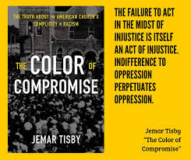

Slide 3
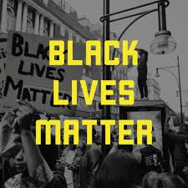
Chapter 10: Reconsidering Racial Reconciliation in the Age of Black Lives Matter (pp. 172-191)

Slide 4
Do you agree or disagree?
Tisby concludes this chapter on “racial reconciliation” with the note that “centuries of racism in the American church cannot be overcome by ‘pious irrelevancies and sanctimonious trivialities’ that ignore the deep social, political, and cultural divides that persist across the color line” (p. 191).

Slide 5
Do you agree or disagree?
Tisby concludes that “those supposedly most equipped for reconciliation [evangelicals] do not see the need for it” (p. 184).”

Slide 6
Chapter 10 Discussion Question
Tisby argues that the Church must undertake “bold, costly actions” to move away from complicity and compromise with racism, so as to move towards courageous racial justice. Where have you witnessed the seeds of change with which you could join?

Slide 7
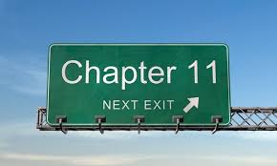

Slide 8
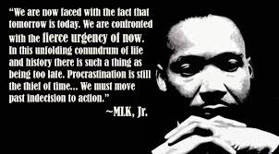
Chapter 11: The Fierce Urgency of Now
What does this quote mean to you?

Slide 9
THOUGHTS???
Tisby adds, “much of the American church has not yet considered racism to be a serious enough sin to interrupt their regularly scheduled worship, at least not much beyond conversations and symbolic gestures, to repair the relationship” (199).

Slide 10
cHAPTER 11 dISCUSSION Question
ARC: Awareness, Relationships, Commitment. As you ponder Tisby’s entire book, assess your ”ARC.” Where have you grown? Where do you need to continue to grow?

