Slide 4
Chapter 7 Remembering the Complicity of the North (pp.111-129)
“Christians of the North [and the West and East coasts] have often been characterized as abolitionists, integrationists, and open-minded citizens who want all people to have a change at equality. Christians of the South, on the other hand, have been portrayed as uniformly racist, segregationist, and antidemocratic. The truth is far more complicated (p. 129).”

Slide 5
Tisby Adds…
“the very conspicuousness of white supremacy in the South has made it easier for racism in other parts of the country to exist in open obscurity.”

Slide 6
Chapter 7 DQ
Tisby discusses the “innocence” of the North (and all of the non-South) is, in part, an effort to challenge the “narratives” of “good” North and “evil” South. How does this reassessment of the historical record cause us to reassess our own “innocence” with regards to racism, inside and outside the church?

Slide 8
Chapter 8: Compromising with Racism during the Civil Rights Movement (pp. 130-151)
Billy Graham argued, “the heart of the problem of race is in loving our neighbor,” a continuation of a theology of early America of fighting racism “one friendship at a time” (pp. 134-135).

Slide 9
Graham and King Difference…
Graham’s view of the riots of the 1960’s
“the rioting, looting and crime in America have reached the point of anarchy and are a dress rehearsal for a revolution (pp.141-142).”
King’s view of the riots of the 1960’s
“we must view riots as the language of the unheard. (p.141).”

Slide 10
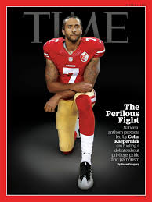

Slide 11
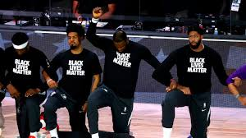

Slide 12
Chapter 8 DQ
Riots, and protest are viewed differently depending on one’s perspective. How can we learn to empathize with others who hold different views, instead of forcing our view to reign supreme?

Slide 14
Chapter 9: Organizing the Religious Right at the end of the Twentieth Century (pp. 152-171)
“After more than three centuries of deliberate, systematic race-based exclusion, the political system that had intentionally disenfranchised black people continued to do so, yet in less overt ways. Simply by allowing the political system to work as it was designed—to grant advantages to white people and to put people of color at various disadvantages—many well-meaning Christians were complicit in racism (p. 171).”

Slide 15
Statement by the Alabama Clergymen
What are your thoughts?
Is this statement sensitive to opposing views?
Is this statement inclusive of the possible emotions, and attacks experienced by Black people during this time?
What could this statement have included to empathize with the plight of the oppressed?

Slide 16
