Slide 1
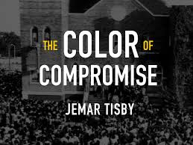

Slide 2
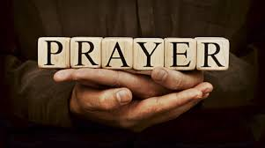

Slide 4
Chapter 4: Institutionalizing Race in the Antebellum Era (pp. 56-69)
He notes that “the nation’s political leaders used Black lives as bargaining chips to preserve the union of states and to gain leverage for other policy issues” (p. 59).
“the American church made similar compromises at critical junctures to preserve the status of slaveholders and to justify the uniquely American manifestation of slavery” pp. 59-60). He adds that, “rather than defending the dignity of Black people, American Christians at this time chose to turn a blind eye to the separation of families, the scarring of bodies, the starvation of stomachs, the generational trauma of slavery” (p. 62).

Slide 5
Q&A FROM CHAPTER 4
As you reflect on these three periods of American history, let the weight of the Church’s passive and active support of racism (e.g., the instutionalization and maintenance of slavery, the dehumanization of African peoples in the Americas) sit with you. How does Tisby’s telling of the American church’s history impact you? How does it shape your relationship to the church today?

Slide 6
Q&A FROM CHAPTER 4
Finally, how have the events of the spring and summer of 2020 called for “religious transformations” (p. 55) in us so that, individually and collectively, we can “deconstruct the foundations of the social pyramid” of racial hierarchy? Where have you seen these “transformations” in progress?

Slide 8
Chapter 5: Defending Slavery at The Onset of the Civil War (pp.70-88)
“The battles of the Civil War did not just happen in places like Shiloh and Gettysburg. The Bible itself became a battleground. With the onset of the Civil War, the nation faced not only a political and economic crisis but a theological one as well.”
Methodists, Baptists, and Presbyterians split over slavery

Slide 9
Genesis 9:25-26 (Slavery, & The Curse of Ham)
²⁵ he said,
“Cursed be Canaan! The lowest of slaves will he be to his brothers.”
²⁶ He also said,
“Praise be to the Lord, the God of Shem! May Canaan be the slave of Shem.

Slide 10
Q&A FROM CHAPTER 5
Lynching, residential segregation, and voter suppression are a few of the scars that Tisby argues are results of either the American church’s silence or outright support. What other scars can you name?

Slide 11
Q&A FROM CHAPTER 5
Tisby focuses on the Black church’s embrace of the cross as a way to “make sense” of lynching. He also notes that the Black church has focused on “the spiritual, political, and social equality of black people.” What lessons can the white church learn from the Black church about suffering, redemption and equality before God?

Slide 12
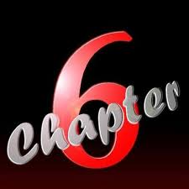

Slide 13
Chapter 6: Reconstructing White Supremacy in the Jim Crow Era (pp. 88-110)
Tisby documents, through the development of the Lost Cause narrative, Jim Crow laws and customs, and the Ku Klux Klan how America and the American church created a new social order designed “to reinforce the inferiority of black people in America” (p. 89).

Slide 14
Application Questions
After reading chapters 4-6 what are your feelings?
In response to America’s addiction to the sin of racism do you believe racial reconciliation is possible?
In the environments where you reside, how can you apply the knowledge revealed in chapters 4-6?

Slide 15
