Slide 1
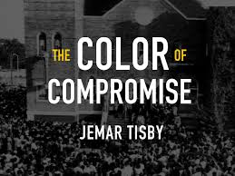

Slide 3
September 15, 1963

Slide 4
What made you stop and reflect in your reading of chapter 1?

Slide 5
On page 24…..
“Progress is possible, but we must learn to discern the difference between complicit Christianity and courageous Christianity."

Slide 7
On page 29…
“Over the next 300 years, the transatlantic slave trade transported more than ten million Africans to the Americas in a forced mitigation of epic scale.”

Slide 9
This negatively impacted families.
This destroyed and affected the self esteem of many.
Slavery took the lives of many.
This reinforced the idea that people of color are inevitable servants and less than others.
Slavery caused generational pain.
Slavery produced wealth for some and worry for many.
Sadly, the effects of slavery continues to be seen in societies actions, structures, and beliefs.

Slide 10
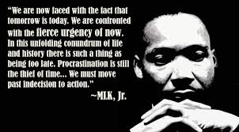

Slide 11
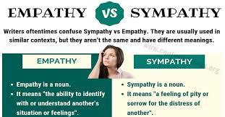

Slide 13
P. 41…..
“When colonists in North America fought and won the war for independence from Britain, they used the rhetoric of liberty and natural rights to argue for the righteousness of their cause. While white soldiers and political leaders were declaring their inalienable right to independence, they were also enslaving countless women, men, and children of African descent.”

Slide 18
P. 55
“The American Church compromised with racism in the eighteenth century by permitting slavery to continue."

Slide 19
The Takeaway Wrap Up
What can we do to personally refrain from compromising in race relations with others?
What hurts you about the history that was revealed in chapters 1-3?
What was most surprising to you about chapters 1-3?
What hope opportunities are available after reading chapter 1-3?

