Slide 1
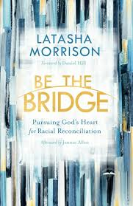

Slide 2
Removing Roadblocks to Reconciliation
“When we honestly acknowledge and lament the truth of our sins (especially racial sins), we will come to face to face with the shame and guilt of our collective past p.69”

Slide 3
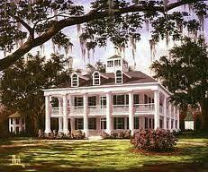

Slide 4
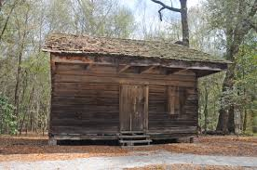

Slide 6
Page 69
“There’s often no mention of how slave families were broken up and members sold to various plantations across the country. There’s no mention of the sex slaves or the children of the plantation owners born by those slave women. There’s no mention of the innovations and advancements made by the slaves, no mention of the fact that much of America was built on their backs.”

Slide 7
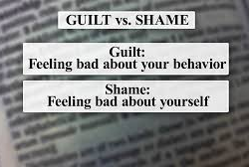
Roadblocks to Reconciliation……
“Let’s not hide from the communal shame and guilt of racism; let’s acknowledge it and step from its shadow and into the light p. 77”

Slide 8
What steps are you taking to lean into the guilt and shame of our past and present, to move deeper into the process of reconciliation?

Slide 9
Chapter 5: Where Healing Begins

Slide 10
Page 87
“Born from white supremacy, colorism among African Americans grew from the belief that whoever had features closer to those of the White slaveholders (often the biracial children of raped slaves) was more valuable, was more beautiful, and as a result would be treated better. This belief has caused deep divisions within our community as lighter-skinned African Americans treated with contempt those with darker skin. This devaluing of our brothers and sisters has perpetuated a kind of self-hate within the youth who have dark skin like mine.”

Slide 11
Confession
James 5:16 says, “Confess your sins to each other and pray for each other so that you may be healed.”
Why is it important for us to confess our sins to one another? How does this differ from confessing our sins to God?

Slide 12
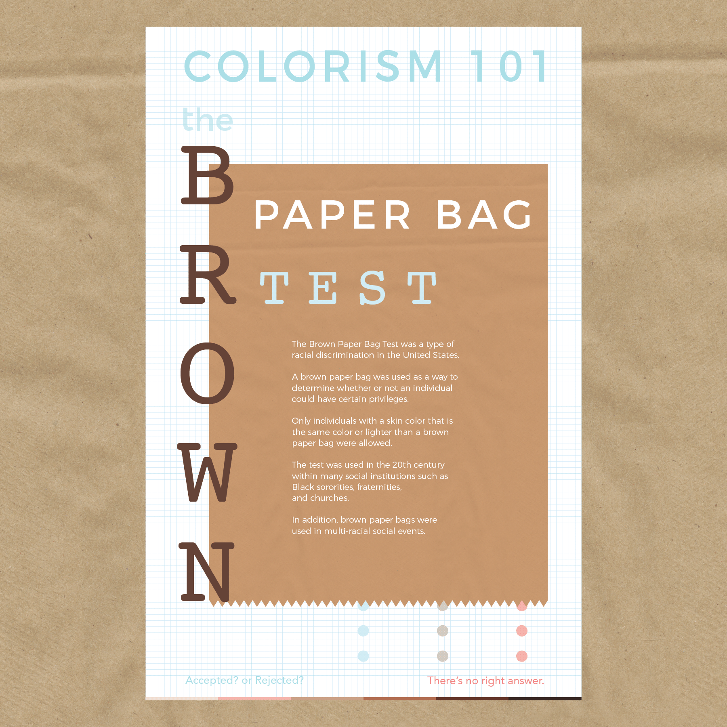

Slide 13
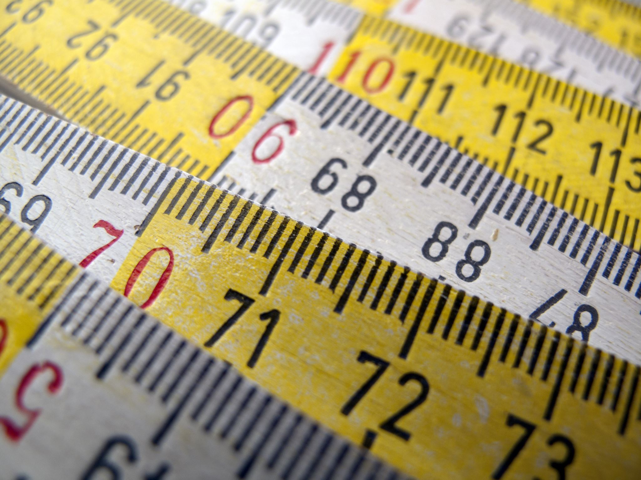
We cannot use color as a measure of worth!

Slide 14
Confession in practice
Have you ever looked down on others because of their ethnicity, their race?
Have you ever thought less of an individual of another ethnic group because of the way they looked?

Slide 15
Chapter 6: The Healing Balm
“That’s how I came to understand the surprising truth: forgiveness wasn’t a gift to those who hurt me; it was a gift to myself p.108”

Slide 16
Practicing Forgiveness
We must understand just how much we need forgiveness extended to us.
Bridge builders don’t deny hurt. They experience it. Sit in it. Feel it. But they don’t stay in the pain.
“Forgiveness is not an occasional act, but a permanent attitude”
- Dr. Martin Luther King Jr.

Slide 17
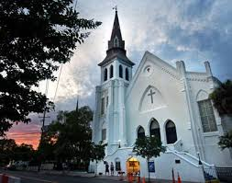

Slide 18
Ending Questions
Examine your life. What specific to racism, colorism, or other forms of prejudice and discrimination do you need to be forgiven for? Who might you need to call or visit and ask for forgiveness?

Slide 19
Ending Questions
Now consider those you might need to forgive. Consider particularly those you might need to forgive for their participation in racism or structural privilege. Consider the Dylann Roofs of the world. Consider the Judge Gosnells’ of the world. Consider the well-meaning people who’ve been blind to structural privilege too, folks like Brooke Park. What would it look like for you to choose forgiveness?

Slide 20
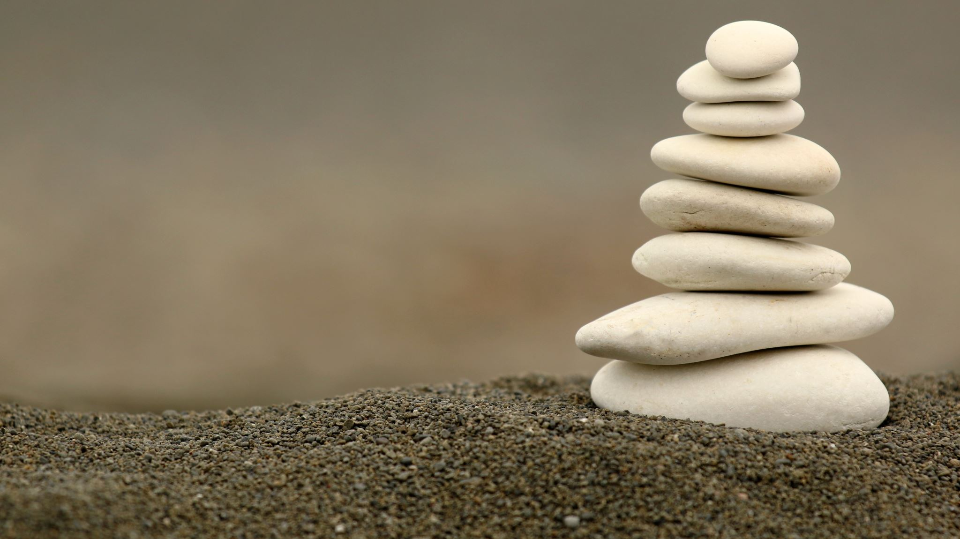
A Liturgy of Confession and Forgiveness
p. 119

