Slide 1
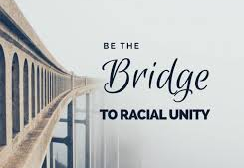

Slide 3
How would you define racial reconciliation?

Slide 4
Racial reconciliation means to change places with the other.
Racial reconciliation is a two-way street.
Racial reconciliation can both be seen as a process and a destination.

Slide 5
Reconciliation is our greatest challenge as we enter the twenty-first century-and it is our only hope.
Curtiss Paul DeYoung

Slide 6
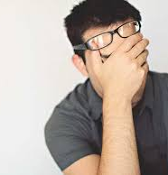
The Problem & Tension
“We live in a fragmented time when people of faith often avoid discussions about race and when those who meaningfully confront the challenges often ignore faith.”

Slide 7
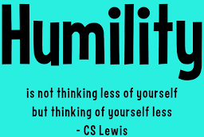
Chapter 1

Slide 8
Chapter 1, page 2
“When we lack historical understanding, we lose part of our identity. We don’t know where we came from and don’t know what there is to celebrate or lament. Likewise, without knowing our history, it can be difficult to know what needs repairing, what needs reconciling.”

Slide 9
Have you studied the history of non-white cultures in America and how those cultures came to be here?

Slide 10
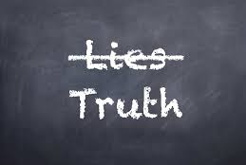
Chapter 2

Slide 11
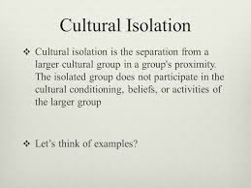

Slide 12
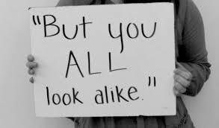
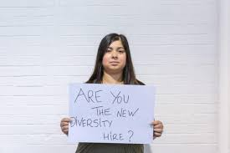

Slide 13
Chapter 2, page 17
“That there are these two perceived types of minorities-assimilated or non-assimilated-has caused so much division in communities, among other races, and within the majority culture. These perceptions create internalized racism, colorism, and our own racial prejudice against other groups and one another.”

Slide 14
“The truth is that each ethnicity reflects a unique aspect of God’s image”

Slide 15
Zechariah 2:11
¹¹ Many nations shall join themselves to the Lord on that day, and shall be my people; and I will dwell in your midst. And you shall know that the Lord of hosts has sent me to you.

Slide 16
Chapter 2, page 23
“But despite the Bible’s recognition of differing ethnic groups, there is no indication of race. Race as we know it, is a political and social construct created by a man for the purpose of asserting power and maintaining a hierarchy. When we believe the lies embedded with racial hierarchies, reconciliation becomes impossible.”

Slide 17
Why do we sometimes try to suppress truth? What motivation might be at work when we avoid engaging with truth?

Slide 18
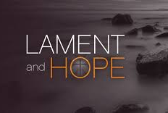
Chapter 3- An Invitation to Acknowledge & Lament
To lament means to express sorrow or regret

Slide 19
Chapter 3, page 41
“As, Americans we love to focus on praise, comfort, thanksgiving, and worship-anything but lament. There is great value to lament. Lament must never be cut off before it has run its course, but lament needs a response. That response comes from the Father above, but could it also require something from us?”
-Soong Chan Rah

Slide 20
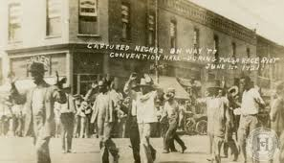

Slide 21
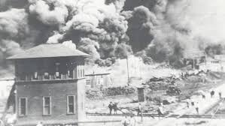

Slide 22
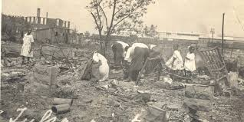

Slide 23
Chapter 3, page 45
“Willful ignorance of the facts, willful bias and prejudice-these things keep us from the awareness that leads to full acknowledgment and lament. They keep us from moving into the hard work of racial reconciliation.”

Slide 24
Lamentations 3:22-23
²² The steadfast love of the Lord never ceases, his mercies never come to an end; ²³ they are new every morning; great is your faithfulness.
How does God come to our rescue through our mourning?

