Slide 1
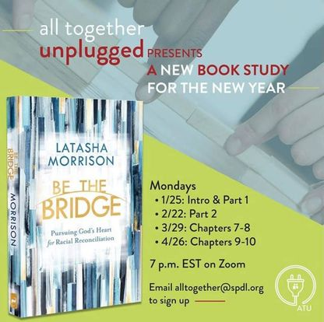

Slide 2
How would you define reconciliation?
“an ongoing spiritual process involving forgiveness, repentance, and justice that restores broken relationships and systems to reflect God’s original intention for all creation to flourish.”
-Brenda Salter McNeil

Slide 3
How would you define restoration?
the action of returning something to a former owner, place, or condition.
The biblical meaning of the word "restoration" is to receive back more than has been lost to the point where the final state is greater than the original condition. The main point is that someone or something is improved beyond measure.

Slide 4
p. 176
“Despite all my work in the field of racial reconciliation, my dad knew something I hadn’t yet learned. He knew that restorative reconciliation is always possible. He knew that split sheets can be mended and relationships can be put back rights. All it takes is a little time, a little understanding, and a worthy cause.”

Slide 5
p. 177
“Bridge builders grow; they mature. And if they’re growing in the right direction, if they’re committed to the work, they’ll eventually learn the way to restoration of healthy relationships. It won’t be easy, but it’s the work of the gospel.”

Slide 6
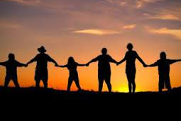
The Goal is to enhance our communal relationships!

Slide 7
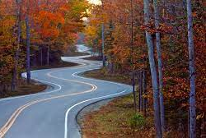
Reconciliation is a long winding road!

Slide 8
Practical ways to pursue reconciliation
https://www.youtube.com/watch?v=6UuF4BFqzrA

Slide 9
The Reflective Question from Chapter 9
What obstacles do you see to restorative reconciliation in our country, your state, your community, and your church?

Slide 10
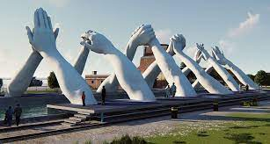
We Build Bridges Together

Slide 11
Reasons we neglect to build bridges….
Fear
Discomfort
Not knowing all of the details from God.

Slide 12
Mark 12:30-31
³⁰ Love the Lord your God with all your heart and with all your soul and with all your mind and with all your strength.’ ³¹ The second is this: ‘Love your neighbor as yourself.’ There is no commandment greater than these.”

Slide 13
Why does reproduction matter in the work of racial solidarity and racial reconciliation?
How do you plan to help your friends, family, and church members understand the work of racial reconciliation? How do you plan to reproduce people who lean into that work?

Slide 14
A Prayer for Reproduction of Bridge Builders
“Lord, grant us wisdom and compassion as we pursue your heart for reconciliation with our brothers and sisters within the church body. Give us open minds and open hearts. Show us where we need to be more Christlike.
Lord, help us to discern those things that divide us, and help us bring them to light. Use us as vessels of your Holy Spirit so we may be your hands and feet to spread your heart for the reconciliation of your children.

Slide 15
A Prayer for Reproduction of Bridge Builders
Illuminate for us, Lord, the path to reconciliation, and help us to look at our own hearts and thoughts. Equip us to be bridge builders for your kingdom. In Jesus’s name. Amen.”
-Manijeh Huereca

