Slide 3
Rules for our time together
Respect is essential.
Empathize don't antagonize.
Please use the “raise hand” feature if you have a comment or question.

Slide 5
Esther 4:14-16
¹⁴ For if you keep silence at such a time as this, relief and deliverance will rise for the Jews from another quarter, but you and your father’s family will perish. Who knows? Perhaps you have come to royal dignity for just such a time as this.” ¹⁵ Then Esther said in reply to Mordecai, ¹⁶ “Go, gather all the Jews to be found in Susa, and hold a fast on my behalf, and neither eat nor drink for three days, night or day. I and my maids will also fast as you do. After that I will go to the king, though it is against the law; and if I perish, I perish.”

Slide 7
Page 141
“Although the president would not acknowledge them, these women refused to give in to the hopelessness that surrounded them on all sides. For months, they organized thousands of local women from different faiths to pray and sing in the fish market. Day after day, week after week, for months, these women gathered to pray and sing. Their mission was to “pray the devil back to hell.”

Slide 8
Have you made praying for harmony among ethnic groups a part of your prayer requests?

Slide 9
Page 142
“Speaking out against injustice and standing up for righteousness begins with an understanding that we cannot simply rely on our own strength or human understanding.”

Slide 10
Page 143
“The Lord says: ‘My thoughts and my ways are not like yours”’ (Isa. 55:8). We must follow God’s strategy and timing because “we are not fighting against humans. We are fighting against forces and authorities and against rulers of darkness and powers in the spiritual world.” (Eph. 6:12).

Slide 11
Why do we tend to think of racism as a human issue instead of a spiritual problem?

Slide 12
Page 149
“When we pray, we acknowledge that we need God in every area of our lives, no matter who we are: we might have a PhD, we might run marathons, we might be tough as nails, we might even be queen, but prayer is our chance to unequivocally communicate with God and remind ourselves that we cannot do the important work of reconciliation without God’s help.”

Slide 13
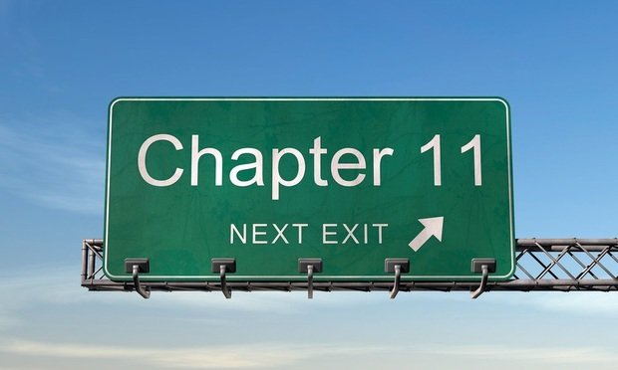

Slide 14
Esther 4:16
¹⁶ “Go, gather all the Jews to be found in Susa, and hold a fast on my behalf, and neither eat nor drink for three days, night or day. I and my maids will also fast as you do. After that I will go to the king, though it is against the law; and if I perish, I perish.”

Slide 15
Civil disobedience is scary!

Slide 16
“The world will not be destroyed by those who do evil, but by those who watch them without doing anything.”
Albert Einstein

Slide 17
What frightens you about taking action against injustice?

Slide 18
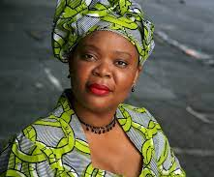
Leymah Gbowee

Slide 19
Page 155
“The one thing I have never been afraid of is standing before important people and speaking my mind. I represent women who may never have the opportunity to go to the United Nations or meet with the president. I’m never afraid to speak truth to power.”

Slide 20
W.E.B. Du Bois “Give Us Grace” Page 159
“Give us grace, O God, to dare to do the deed which we well know cries to be done. Let us not hesitate because of ease, or the words of men’s mouths, or our own lives. Mighty causes are calling us-the freeing of women, the training of children, the putting down of hate and murder and poverty-all these and more. But they call with voices that mean work and sacrifice and death. Mercifully grant us, O God, the spirit of Esther, that we say: I will go unto the King and if I perish, I perish.”

Slide 22
Esther 5:1-5
On the third day Esther put on her royal robes and stood in the inner court of the palace, in front of the king’s hall. The king was sitting on his royal throne in the hall, facing the entrance. ² When he saw Queen Esther standing in the court, he was pleased with her and held out to her the gold scepter that was in his hand. So Esther approached and touched the tip of the scepter. ³ Then the king asked, “What is it, Queen Esther? What is your request? Even up to half the kingdom, it will be given you.”

Slide 23
Esther 5:1-5
⁴ “If it pleases the king,” replied Esther, “let the king, together with Haman, come today to a banquet I have prepared for him.”
⁵ “Bring Haman at once,” the king said, “so that we may do what Esther asks.”
So the king and Haman went to the banquet Esther had prepared.

Slide 24
Tikkun Olam
Is interpreted as an aspiration for humanity to behave and act in partnership with God by taking steps to improve the state of the world through helping others.

Slide 25
What thoughts, steps, or actions are you committed to that can repair the world?

Slide 26
“You don’t fix the world without personal risk.”
Page 164

Slide 27
Page 173
“Fear is one of the persistent hound of hell that dog the footsteps of the poor, the dispossessed and the disinherited.”

Slide 28
Esther 7:3-6
³ Then Queen Esther answered, “If I have found favor with you, Your Majesty, and if it pleases you, grant me my life—this is my petition. And spare my people—this is my request. ⁴ For I and my people have been sold to be destroyed, killed and annihilated. If we had merely been sold as male and female slaves, I would have kept quiet, because no such distress would justify disturbing the king.”

Slide 29
Esther 7:3-6
⁵ King Xerxes asked Queen Esther, “Who is he? Where is he—the man who has dared to do such a thing?” ⁶ Esther said, “An adversary and enemy! This vile Haman!” Then Haman was terrified before the king and queen.

Slide 30
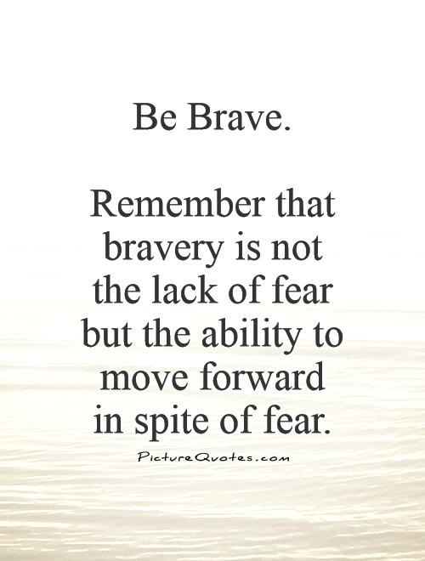

Slide 31
Ubuntu means humanity to others

Slide 32
Father Robert Schreiter accurately states,
“Reconciliation makes of both victim and oppressor a new creation.”

Slide 33
Steps Forward
Reclaim our identity and agency as people of color
1
Confront Whiteness
2
Repair broken systems together
3
Restore the credibility of the Church.
4

Slide 34
We are Reconcilers!

