Slide 3
Rules for our time together
Respect is essential.
Empathize don't antagonize.
Please use the “raise hand” feature if you have a comment or question.

Slide 4
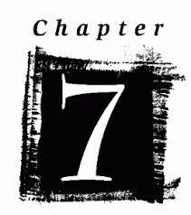

Slide 5
Esther 4:5-7
⁵ Then Esther summoned Hathak, one of the king’s eunuchs assigned to attend her, and ordered him to find out what was troubling Mordecai and why.
⁶ So Hathak went out to Mordecai in the open square of the city in front of the king’s gate. ⁷ Mordecai told him everything that had happened to him, including the exact amount of money Haman had promised to pay into the royal treasury for the destruction of the Jews.

Slide 6
Our stories matter! Page 105
“The story a person tells about other people really matters. I’ve learned to be much more careful and conscious of the stories being told to me about others. I pay attention to who is telling the story and their purpose in telling it. I also know that where someone begins the story shapes the overall narrative being told.”

Slide 7
Pray for open eyes and open hearts.

Slide 9
Page 108
“Usually when one person offends another, their dispute is between the two of them. However, instead of settling the score with Mordecai, Haman decided to take out his anger on all the Jews. He saw his chance to destroy not just Mordecai but all the Jews throughout the king’s provinces.”

Slide 10
Page 108
“In essence, he’s saying, “Look at these people! They are different. Their customs are different. They are not like us; therefore, they are less than us. They are a threat to us!” Sound familiar? This is the same type of divisive rhetoric we hear today.”

Slide 11
What makes humanity choose fear and anger over the dignity of each individual?

Slide 12
Implicit Bias
To describe when we have attitudes towards people or associate stereotypes with them without our conscious knowledge.

Slide 13
Page 113
“We aren’t bad or unjust or unkind people. We just don’t know what’s going on. Or if we do know, we’re not sure we can actually do anything about the political and entrenched nature of systemic evil. However, like Esther, we are now aware of the problem and we know that people’s lives are being destroyed. Mordecai’s lament is calling Esther and us into action. What are we going to do now?”

Slide 14
Micah 6:8
⁸ He has shown you, O mortal, what is good. And what does the Lord require of you? To act justly and to love mercy and to walk humbly with your God.

Slide 15
Isaiah 1:17
¹⁷ Learn to do right; seek justice. Defend the oppressed. Take up the cause of the fatherless; plead the case of the widow.

Slide 17
Esther 4:8-9
⁸ He also gave him a copy of the text of the edict for their annihilation, which had been published in Susa, to show to Esther and explain it to her, and he told him to instruct her to go into the king’s presence to beg for mercy and plead with him for her people.
⁹ Hathak went back and reported to Esther what Mordecai had said.

Slide 18
James Baldwin
“If I love you, I have to make you conscious of the things that you don’t see.”

Slide 19
Page 117
“Assimilating may work when it’s about your own comfort and well-being, but when you realize that other people’s lives are at stake, you cannot be concerned only with your own personal safety or professional advancement-you have to step out.”

Slide 20
What steps are you taking to educate yourself about the needs and stories of others?

Slide 21
Anthony Ray Hinton
You’re Black
The victim is White
The prosecuting attorney will be White.
The judge will be White.
The jury will most likely be all White.
“Do you know what that spells? Conviction.”

Slide 22
“Racism is a systemic evil that robs people of their ability to thrive.”
Page 120

Slide 23
Pages 121-122

Slide 24
“Practicing Proximity”

Slide 25
On Page 124 Bryan Stevenson says,
“When we get close, we hear things that can’t be heard from afar. We see things that can’t be seen. And sometimes that makes the difference between acting justly and unjustly…When you get close to injustice, you will get broken, too. But I’m here as a living witness that being broken is what makes you human.”

Slide 27
Esther 4:10-14
¹⁰ Then she instructed him to say to Mordecai, ¹¹ “All the king’s officials and the people of the royal provinces know that for any man or woman who approaches the king in the inner court without being summoned the king has but one law: that they be put to death unless the king extends the gold scepter to them and spares their lives. But thirty days have passed since I was called to go to the king.”

Slide 28
Esther 4:10-14
¹² When Esther’s words were reported to Mordecai, ¹³ he sent back this answer: “Do not think that because you are in the king’s house you alone of all the Jews will escape. ¹⁴ For if you remain silent at this time, relief and deliverance for the Jews will arise from another place, but you and your father’s family will perish. And who knows but that you have come to your royal position for such a time as this?”

Slide 29
Page 127
“All the power, prestige, and privilege that she had become accustomed to could possibly be gone in the blink of an eye. It would give anyone pause. Not to mention that the queen who had come before her had already been banished. Esther knows that the same fate could await her, or possible even worse if she dares to step out of line.”

Slide 30
What calls for courage could you be overlooking?

Slide 31
Page 128, Roy Goble says,
“The poor and oppressed often live with the affliction of despair ( a lack of hope), while the rich often live with the affliction of self indulgence ( a lack of faith). The poor can learn a lot from the rich about hope; the rich can learn a lot from the poor about faith. Both, of course, can teach each other a lot about love.”

Slide 32
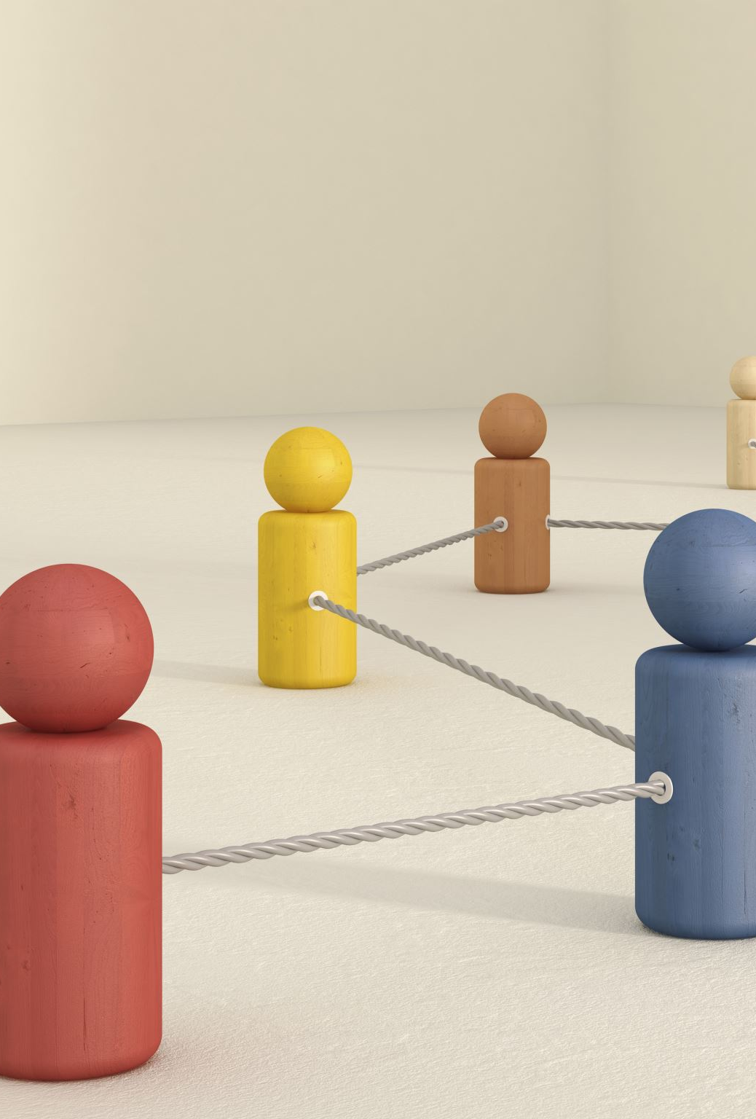
Ally
One who seeks to stand with, unite, or form a connection between individuals, groups, and or communities.

Slide 33
Page 131
“Silence has the potential to do unbelievable damage. Silence can be violent. Silence isn’t passive. Silence is active, and it carries with it the power, in the case of Esther and so many others, to fuel atrocity and unthinkable hatred. Now it is the time for Esther and us to venture beyond solidarity and into activism.”

Slide 34
Frederick Buechner tells us,
“Wherever people love each other and are true to each other and take risks for each other, God is with them and for them and they are doing God’s will.”

