Slide 4
Esther 2:10-11
¹⁰ Esther had not revealed her nationality and family background, because Mordecai had forbidden her to do so. ¹¹ Every day he walked back and forth near the courtyard of the harem to find out how Esther was and what was happening to her.

Slide 5
The call to reconciliation is heavy. Page 64
“I can’t play that role for you anymore. I can’t be that person for you. I can’t carry this for you. I need you to do your work. Yes, I need you to do your work.”

Slide 6
April 4, 2014

Slide 7
Page 67-68
“As a mother of black children, I have an additional list of things I tell my kids in hopes that they will stay safe. If you are a black person or a person of color in the United States, you know what I’m talking about!
Keep your hands where folks can see them. Be mindful how you look to others. Speak English. Don’t wear a hoodie or walk that way when you’re in public. If you get stopped by the police while driving, keep your hands on the steering wheel, don’t ask questions, and definitely don’t talk back”

Slide 8
Why do rules such as these have to be a reality?

Slide 9
Don’t be different. Blend in. Hide who you really are.
This is harmful, but the only way many survive!

Slide 10
Code switching vs Divergent speech
Describes the ways people move back and forth between different languages and ways of communicating depending on their social context.
Is when a speaker emphasizes the social distance between themselves and other speakers by using speech with linguistic features characteristic of and familiar only to their cultural group.

Slide 11
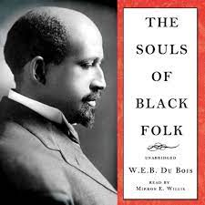

Slide 12
Page 76
“However, we now live in an increasingly connected global society and can no longer function from this posture of assumed distant superiority. Therefore, those of us who truly want to be culturally competent, globally relevant, and socially active reconcilers must learn to speak other languages.”

Slide 13
Moving towards reconciliation
Prepare
Grow
Learn

Slide 15
Esther 2:17,19-20
¹⁷ Now the king was attracted to Esther more than to any of the other women, and she won his favor and approval more than any of the other virgins. So he set a royal crown on her head and made her queen instead of Vashti. ¹⁹ When the virgins were assembled a second time, Mordecai was sitting at the king’s gate. ²⁰ But Esther had kept secret her family background and nationality just as Mordecai had told her to do, for she continued to follow Mordecai’s instructions as she had done when he was bringing her up.

Slide 16
Page 82
“However, we will not be able to be God’s agents of reconciliation if we stay secluded in worlds that keep us from the reality of what is happening around us.”

Slide 17
Esther became isolated and insolated from what was happening outside the palace

Slide 18
“Ignorance and isolation feed off our fear and vice versa.”
Page 83

Slide 19
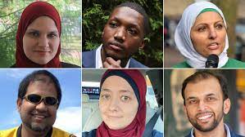

Slide 20
“When people are ignorant of the truth, they will accept any lie, and lies left unchecked can become dangerous.”
Page 85

Slide 21
Why do we find it so easy to be led by our ignorance, rather than to be led by God in our actions?

Slide 22
We must begin to examine our,
Position
Privilege
Power

Slide 23
Page 90-91
“We need to listen to these prophetic voices-protestors, teachers, journalists, artists, preachers-that come to get our attention and inform us about the reality of what’s going on in people’s lives.”

Slide 24
3 Questions we can ask ourselves frequently
How am I isolating myself?
How am I insulating myself?
In what ways is this making me ignorant?

Slide 26
Esther 4:1-4
When Mordecai learned of all that had been done, he tore his clothes, put on sackcloth and ashes, and went out into the city, wailing loudly and bitterly. ² But he went only as far as the king’s gate, because no one clothed in sackcloth was allowed to enter it. ³ In every province to which the edict and order of the king came, there was great mourning among the Jews, with fasting, weeping and wailing. Many lay in sackcloth and ashes.
⁴ When Esther’s eunuchs and female attendants came and told her about Mordecai, she was in great distress. She sent clothes for him to put on instead of his sackcloth, but he would not accept them.

Slide 27
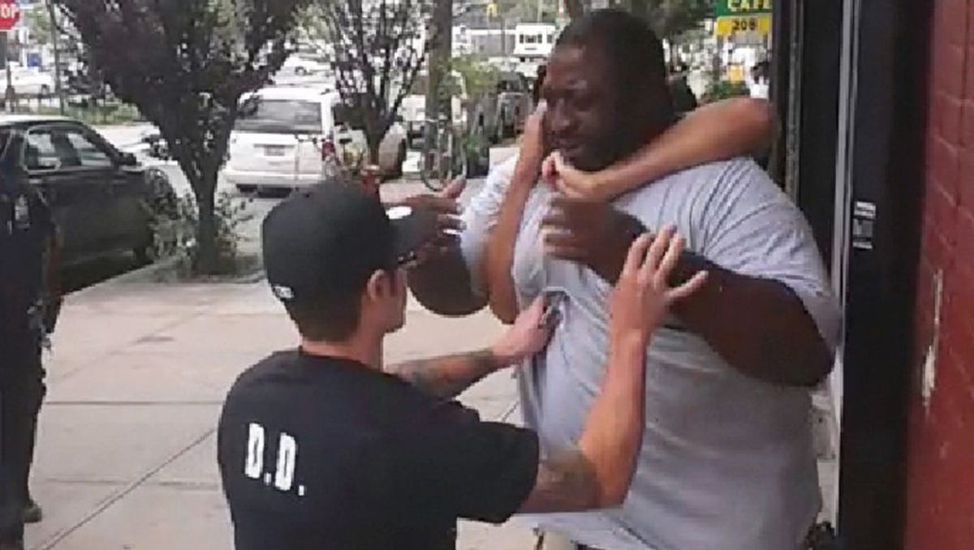
July 17, 2014

Slide 28
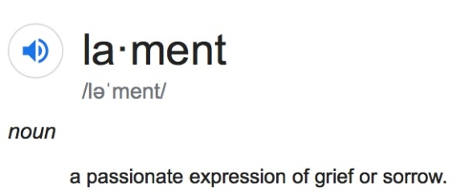

Slide 29
Page 97
“He is saying, I will not let you silence me. I will not let you placate me. I will not go away quietly. I refuse to be pacified. I will not allow you to shut me up or force me to compose myself because I make you feel uncomfortable. No!”

Slide 30
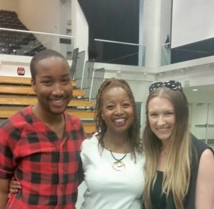
Page 97-99 Bethany Barnes

Slide 31
“We will no longer act like things don’t exist just because they don’t affect us or our lives or make us feel uncomfortable thinking about.”

Slide 32
“We know that racism is not a thing of the past, but a thing of the present and our future if we do not do something. We acknowledge our privilege, take responsibility for our action and inaction, and want to put an end to this centuries-long narrative that is still alive today.”

