Slide 3
Rules for our time together
Respect is essential.
Empathize don't antagonize.
Please use the “raise hand” feature if you have a comment or question.

Slide 4
“Why is it so hard for Christians to make any real, significant progress in dealing with issues of race?”
p.27

Slide 5
Unwillingness
Differing perspectives
Apathy
Ignorance
An unhealthy marriage to comfort.

Slide 6
Page 32
“Many of us don’t think of ourselves as activists. In the face of enormous global and national issues, we can feel numb. I read the headlines, and you know what I want to do sometimes? I want to get back in the bed and pull the covers over my head.”

Slide 7
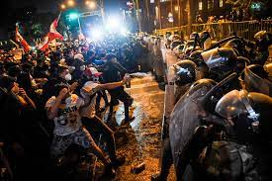

Slide 8
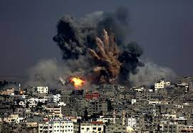

Slide 10
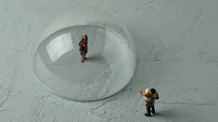

Slide 11
Laquan McDonald

Slide 12
Page 37
“I think it’s the church’s responsibility to call for justice. There are many people calling for justice tonight all over America. However, ours is undergirded with a call for righteousness.”

Slide 13
Daniel Hill

Slide 14
Page 38
“We must take the problem of whiteness more seriously in order to help churches become racially transformed communities of justice and equality. For reconciliation to accomplish its true goal, it is critical to understand whiteness as a social construct created to divide racial groups and assert the superiority of one group over others. The concept of race was developed as a way of categorizing, labeling, and separating human beings on the basis of their physical characteristics such as hair texture, head shape, and skin color.”

Slide 15
Page 38
“Being white is not a sin in and of itself. But “whiteness”-the elevation and valuation of those who are white above all other racial groups, and systems and structures that support this elevation-is evil.”

Slide 16
What can be done about this?

Slide 17
Esther 2:7-8
⁷ Mordecai had a cousin named Hadassah, whom he had brought up because she had neither father nor mother. This young woman, who was also known as Esther, had a lovely figure and was beautiful. Mordecai had taken her as his own daughter when her father and mother died.
⁸ When the king’s order and edict had been proclaimed, many young women were brought to the citadel of Susa and put under the care of Hegai. Esther also was taken to the king’s palace and entrusted to Hegai, who had charge of the harem.

Slide 18
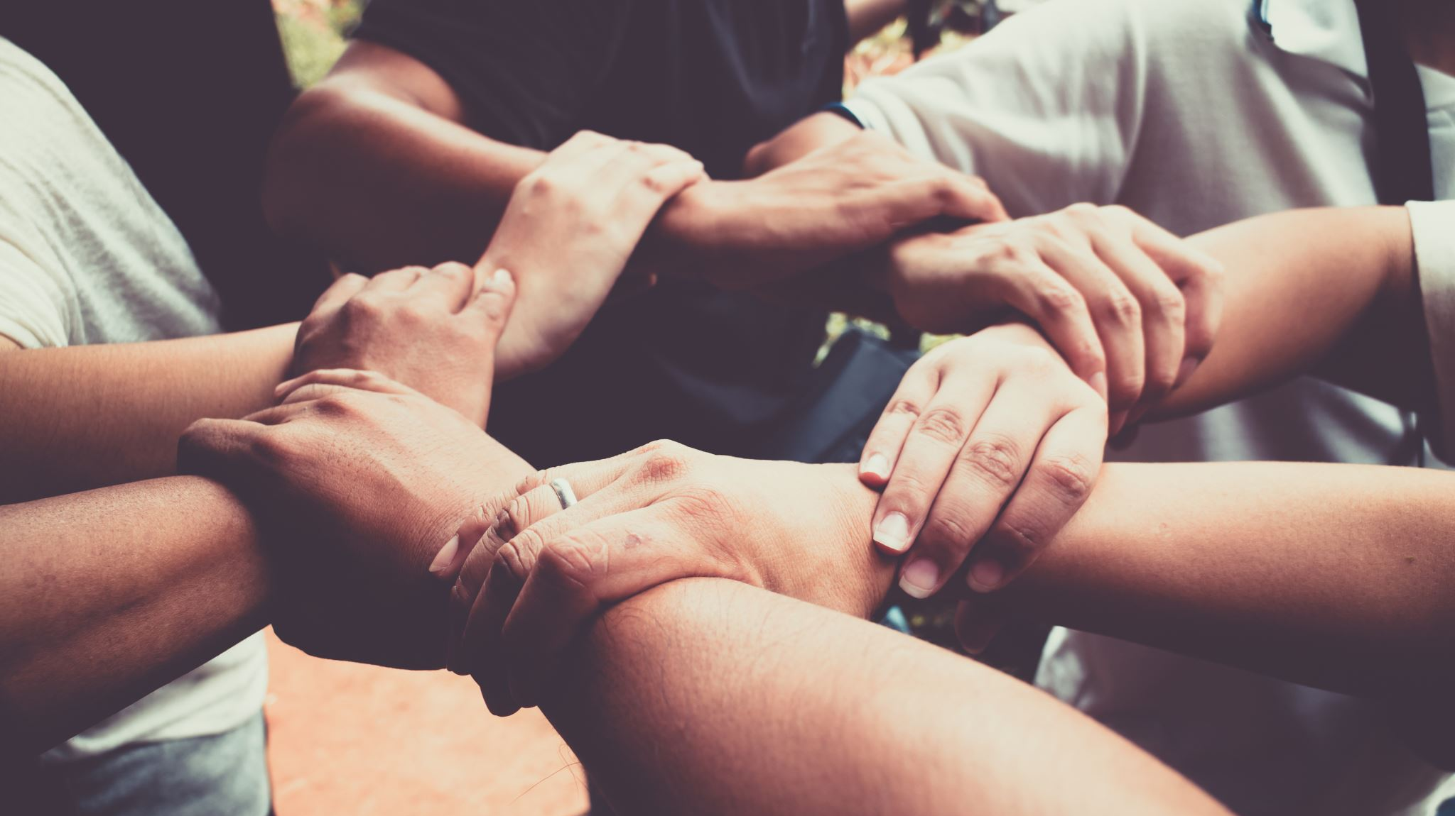
Courage and Empathy is needed to pursue reconciliation!

Slide 19
Reflect
Who has experienced pain due to your silence?

Slide 21
Jennifer Harvey argues…..
Reducing reconciliation to one of inclusion and diversity without insisting on justice is not the goal.

Slide 22
What called you forth?

Slide 23
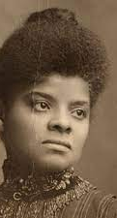
Ida B. Wells Queen Vashti
Both women paved the way for great movements in history to occur.
They were courageous, and very brave.

Slide 24
We are all unlikely activists.

Slide 25
Is there anything happening in the world around you that may be calling you forth?

Slide 26
1 Chronicles 12:32
³² The tribe of Issachar supplied 200 leaders, along with all of their relatives under their command. They kept up-to-date in their understanding of the times and knew what Israel should do.

Slide 27
“We are being called forth. The only question now is how we are going to respond to the call.”
Page 61.

